Slide 1
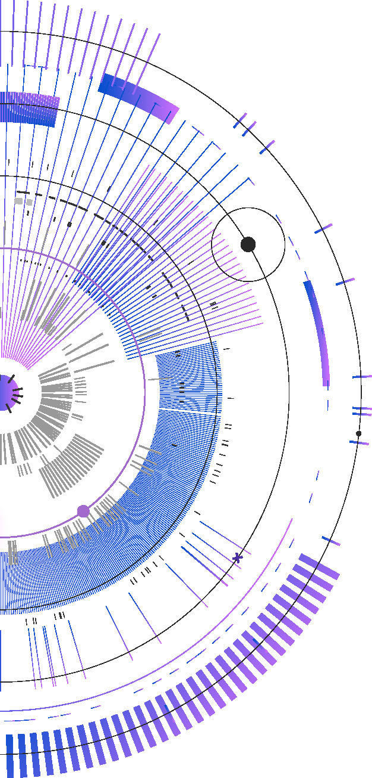

AI System Architecture
an
80% of AI projects do not go into production
https://www.rand.org/pubs/research_reports/RRA2680-1.html (2024)
Twice the rate of non AI projects

Slide 2

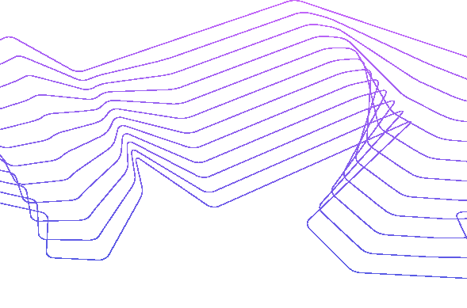
Outline
Terminology
Architecture of Foundation Models
Quality Attributes

Slide 3
Terminology
Narrow ML Models – Designed for specific tasks using custom-collected and labeled datasets.
Foundation Models (FMs) – Large, pretrained on extensive datasets for general purposes, adaptable to a variety of specific tasks.
Large language models (LLMs) are a subtype of FMs
Symbolic AI are rule based systems.
Artificial Intelligence
Machine Learning
Symbolic AI
Narrow ML
Foundation Models
Large Language Models

Slide 4
Focus of This Talk
Artificial Intelligence
Machine Learning
Foundation Models
Large Language Models

Slide 5
Neural Nets
Neural Nets are a form of Machine Learning.
A neural network consists of interconnected layers of nodes (or neurons). These layers include an input layer, one or more hidden layers, and an output layer.
Each node processes information and passes it along to the next layer. The connections between nodes have weights that are adjusted during the learning process to improve the network's accuracy.
Deep learning is a specialized subfield of machine learning that focuses on neural networks with multiple layers (hence the "deep" in deep learning).

Slide 6
Foundation Models
Foundation Models (FMs) are extremely large neural networks trained on massive and diverse datasets. often comprising billions or even trillions of data points.
The training data is largely unlabeled,
FMs are general purpose but can be customized for particular applications.
Large language models (LLMs) are a type of FMs.

Slide 7
Customizing FMs
Foundation models are trained on unlabeled data. They must be customized for specific tasks.
They can be customized by adding context information to the input query.

Slide 8
What are Foundation Models used for?
Natural Language Processing
Text Machine translation
Question answering
Summarization
Image generation and classification
Object detection
Code Generation:
Other Applications – still being explored.

Slide 9
Outline
Terminology
Architecture of Foundation Models
Quality Attributes

Slide 10


Layers in a Foundation Model
or
Software agent
Application
Proxy/Orchestrator
Model Serving
Hardware

Slide 11
Application
Includes
Customization
Guardrails

Slide 12
Customization
Makes FM specific for application.
Performed by “prompt engineering”
Adjust queries to include more specific prompts.
RAG (Retrieval Augmented Generation) uses an application specific database to augment the prompts.

Slide 13
Guardrails
AI guardrails are preventative and reactive measures that act as safety nets for AI systems
These mechanisms aim to mitigate risks associated with AI, such as bias, harmful content generation, misinformation, privacy breaches, security vulnerabilities, and non-compliance with regulation

Slide 14
Proxy/Orchestrator
Abstraction and simplification
Access Control and Security
Monitoring and Logging
Load Balancing and Traffic Management
Model Versioning and Routing
Enhanced Observability

Slide 15
Abstraction and Simplification:
The proxy layer offers a simplified interface for developers and applications. This abstraction facilitates easier integration and interaction with the AI system.

Slide 16
Access Control and Security
The proxy layer acts as a gatekeeper and enforces authentication and authorization protocols, ensuring that only authorized entities can access the AI models.

Slide 17
Monitoring and Logging
The proxy layer monitors requests and responses, allowing for detailed logging.
This supports auditing, debugging, and ensuring compliance with regulatory standards.

Slide 18
Load Balancing and Traffic Management
In scenarios with high traffic, the proxy layer can distribute requests across multiple instances of the AI model.

Slide 19
Model Versioning and Routing
The proxy can intelligently route requests to different versions of the AI model based on criteria such as user roles, request types, or experimental configurations.
This facilitates A/B testing and gradual rollouts of new model versions.

Slide 20
Enhanced Observability
The proxy layer aids in understanding usage patterns, detecting anomalies, and making informed decisions about system improvements.

Slide 21
Model Serving
Knowledge Base (Vector Space)
Inference Engine (Attention mechanism)

Slide 22

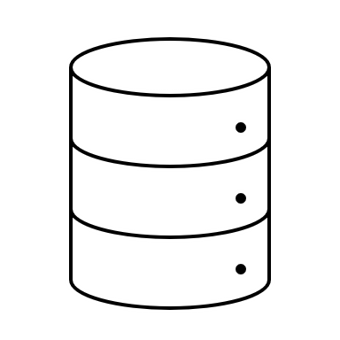
Knowledge Base
The quality of the total system depends on the quality of the knowledge base.
This, in turn, depends on the training data.
The training data should cover the expected uses of the knowledge base in both breadth and depth.
Knowledge
Base
Training
Data

Slide 23
Vector space
Vector encoder
Tokenized sentence
N dimensional mathematical vectors
Vector space is an encoding of the training data
Sentence is broken into tokens (think syllables)
Each token is represented as a vector
Sentence is represented as a collection of vectors
Dimension of vectors may be in the thousands

Slide 24
Inference Engine
Inference Engine is, typically, based on the attention mechanism.
Given a sentence, the tokens in the sentence define a collection of regions in vector space.
Attention is the process of analyzing those regions and their order to extract meaning from the sentence.

Slide 25
Hardware
Attention mechanism involves manipulation of matrices with dimensionality of thousands.
This requires chips specialized for these matrix operations
It also requires software that can deliver the matrices to the chips in volume

Slide 26
Typical Allocation
Laptop or edge device
Application
Split between laptop/edge and cloud
Proxy/Orchestrator
Model Serving
Cloud

Slide 27
Outline
Terminology
Architecture of Foundation Models
Quality Attributes

Slide 28
Quality Attributes
A quality attribute (QA) is a measurable or testable property of a system that is used to indicate how well the system satisfies the needs of its stakeholders beyond the basic function of the system.” E.g. performance, security, availability, modifiability, …

Slide 29
Three Differences Between AI and Non AI Systems
Vocabulary
Nuances
Types

Slide 30
Vocabulary
Terms mean different things to Data Scientists than to Software Engineers or to DevOps Engineers.
Performance, for example.
To a Data Scientist, performance means accuracy of the models' predictions.
To a Software Engineer, performance means latency and throughput.
To a DevOps Engineer, performance means cycle time for deployment.

Slide 31
Nuances
Some QAs have expanded meanings because of the importance of data in achieving the QA. E.G,
Security has a broader attack surface because of the possibility of corrupting data.
Reliability must consider whether the input data is within the distribution of the training data.

Slide 32
Types
Additional QAs become important for AI systems.
We will briefly touch on the following QAs.
Observability
Privacy
Reliability
Security

Slide 33
Observability - Definition
Observability in computer systems allows an external agent, whether human or another system, to understand the actions of the system based on outputs during development, operation, and model training.

Slide 34
Approaches for Enhancing Observability
Two Approaches for Achieving Observability
Recording system activity
Tracing lineage of data items and components

Slide 35
Types
Additional QAs become important for AI systems.
We will briefly touch on the following Qas.
Observability
Privacy
Reliability
Security

Slide 36
Privacy Rights
Right to Know - Individuals can find out what personal information is collected about them, how it's used, and shared.
Right to Delete - Individuals can request the deletion of their personal information.
Right to Opt-Out - Allows individuals to opt-out of the sale or sharing of their personal information.

Slide 37
Privacy Rights
Right to Correct - Individuals can correct inaccuracies in the personal information that businesses hold about them.
Right to Limit Use - There are restrictions on how sensitive personal information can be used or disclosed.

Slide 38
Guardrails are Basic Mechanisms for Privacy
A guardrail monitors input or output from an FM
Can reject input that asks for personal or sensitive information
Can reject input that attempts to add misinformation
Can reject output that contains personal, sensitive data or misinformation.

Slide 39
Types
Additional QAs become important for AI systems.
We will briefly touch on the following Qas.
Observability
Privacy
Reliability
Security

Slide 40
Reliability - Definition
Reliability refers to the consistent and accurate performance of a system
over time,
under specified conditions,
without failure.
It encompasses the system's ability to produce correct and trustworthy outputs, even when faced with unexpected inputs or changes in its environment.

Slide 41
Achieving Reliability
Reliability includes a model's capacity to perform effectively when introduced to new data.
This new data should either fall within the distribution of the training data or be similar to it,
Depends on the training data
The training data represents the real-world scenario the model is intended to address.
The assumption is that the model can generalize beyond its training data to other data within the specified scenario.

Slide 42
Types
Additional QAs become important for AI systems.
We will briefly touch on the following Qas.
Observability
Privacy
Reliability
Security

Slide 43
CIA properties
Confidentiality – only authorized parties can access data or resources.
Integrity - data is accurate, complete, and has not been altered or modified by unauthorized parties
Availability – there is timely and reliable access to data, systems, and services.

Slide 44
Zero Trust
Approach to security
Never Trust, Always Verify - Every access attempt must be thoroughly authenticated, regardless of the user's location or the device used.
Least Privilege Access - Users are granted access only to the resources necessary for their specific roles, minimizing potential exposure to sensitive information.
Continuous Monitoring - Continuous monitoring of all users and devices within the network to detect and respond to anomalies in real time.
Secure Communication - Emphasizes the use of HTTPS over HTTP to secure data transmissions across the network.

Slide 45
Attack Surface and Attack Vectors
An attack surface is the sum of all points where an attacker can potentially interact with a system or network.
An attack vector is a method or pathway that an attacker can exploit to gain unauthorized access to a system or network.

Slide 46
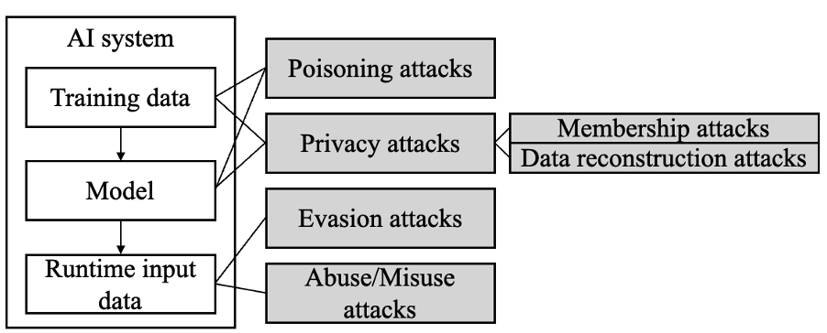
Major attack types

Slide 47
Common Attack Vectors
Query Attacks - Attackers can manipulate the model through crafted queries that exploit the model's response mechanism, potentially altering its behavior or extracting sensitive information.
Supply Chain Vulnerabilities - Organizations often use FMs provided by third parties through APIs, leading to potential risks in the supply chain. It’s crucial to monitor and understand any updates to the model and its infrastructure, which could unexpectedly affect the FM’s performance or behavior.
Learning from Queries - FMs can adapt based on the queries they process, presenting an additional vector where malicious queries could influence the model’s learning process, leading to skewed or biased outputs.

Slide 48
Approaches for Security
Guardrails
Adaptive Training Techniques

Slide 49
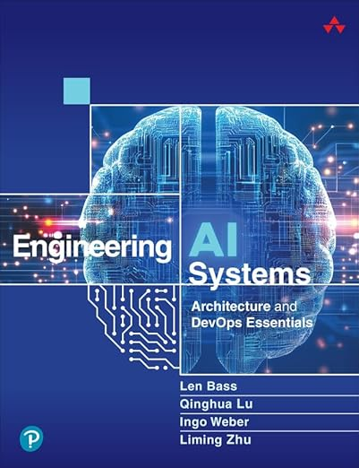
More Information/Questions
Engineering AI Systems: Architecture and DevOps Esstentials
by
Bass, Lu, Weber, Zhu

Slide 50












Thank you
Powered by:

